Slide 1
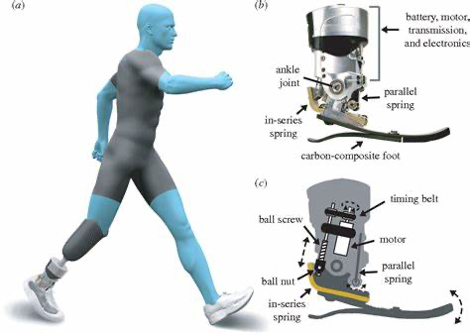
BioM’s bionic ankle

Slide 2
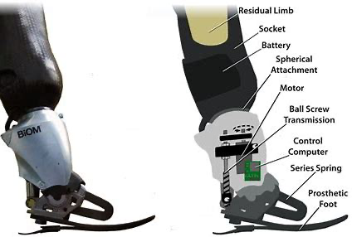
Ottoback Meridium’s Bionic ANkle

